Slide 1

COMPENG 2SH4 Topic 6
Debugging Basics
Dr. Shahrukh Athar
Download both pieces of source code from “Codes for Debugging” and launch.json file under Topic 6 folder on Avenue.
Credit: The current version of these slides has been developed by Dr. Scott Chen (2SH4 F23 C02). I am using these slides with his permission and have made only slight modifications.

Slide 2

Agenda
Debugging Basics
  Common Bug Types
  Tool 1 – Debugging Messages
  Tool 2 – VSCode Debugger
Debugging Practice
  Fibonacci Sequence
  Segmentation Failure
  Generating Debug Report

Slide 3

Debugging Basics
Watch Before Lecture:
[PLV 6-1] Introduction to Debugging Tools

Slide 4
Common Bug Types
Syntactic Bug
  Easy fix (relatively speaking)
  Can fix 99% of syntactic bugs just by following the compiler messages
Semantic Bug (Behaviour Bug)
  Your program compiles but behaves incorrectly
    Logic Flaws, Careless Mistakes, Assuming correct intermediate output without validation
  This is where the Debugging Tools will help
Memory Bug
  Your programs may run correctly, but unstable
    Segmentation Fault, Memory Leakage, Stack Overflow, Unexpected Crashes, etc.
  This is where the Memory Profiler will help
Sporadic Bug / Race Condition (out of scope)
This is our focus

Slide 5
Debugging Tool 1 – printf()
Debug Message
  The quick-and-simple approach to validating intermediate program outputs
  No external debugging tools required
Typical Usages
  Put down printf() statements at the end of each small algorithm block for validation
    Remove the printf() statements once validated
  Put down printf() statements around the suspected bug location
    Compare outputs against expected ones
    Analyze the bug mechanism and fix the bug
    Validate the fix using the same printf() statements
    Remove the printf() statements once validated
Discussed in detail in the Pre-Lecture Video [PLV 6-1]

Slide 6
Debugging Tool 2 – IDE Debugger
Slow Down the Program for the Best WYSIWYG Experience
  We will focus on the setup and usages of VSCode IDE debugger (GNU Debugger, GDB, in the background)
  Most C debuggers are GDB or LLDB in the background. Knowledge 100% transferrable.
Basic Debugger Commands
  Breakpoint
    Line, Function, Watchpoints
  Start / Execute
  Stop / Terminate
  Continue
  Step
    Step, Step Over, Step Into, Step Out
  Print Variable Values
Let’s use the same Fibo.c in PLV 6-1 to demonstrate the usages of GDB

Slide 7
VSCode IDE Debugger - Preparation
Prepare for VSCode Debugging Session
  VSCode debugger requires the workspace to be set to the folder containing the code / project to be debugged
  Close current workspace: File → Close Folder
  Then select File → Open Folder (This sets your VSCode workspace to the respective folder)
  Locate and open the folder containing the downloaded code to be debugged
  Create the .vscode folder inside the current workspace
    Then place launch.json script that configures your VSCode for C/C++ debugging in this folder
  Once done, compile the source code with –g switch to compile the program with debugger features
    gcc example.c –o example -g
  Open launch.json under the .vscode folder
    Set the property “program”: “${workspaceFolder}/example” (where example is the executable file name that you want to debug)
    If you have console IO involved, Set the property “externalConsole”: true

Slide 8

VSCode IDE Debugger – Breakpoints
Setting Up your Code for Debugging: Breakpoints
  A breakpoint can be inserted at a selected statement in your program such that
    When Debugger executes your program, it halts the execution at the statement with the breakpoint
    It enables the debugger to atomically step through your program statement-by-statement
    It also enables you to examine the values in all the variables of your interest at every statement
  You can almost think about breakpoint as a printf() statement during debugging stage, except more powerful
  [WARNING] Without breakpoints, Debugger will run your program at normal speed without showing you any execution information.
  Insert a Breakpoint
  Click on the left side of the line number to insert a “red dot”.
  Remove a breakpoint
  Click on the red dot to toggle it off.

Slide 9

VSCode IDE Debugger – High Level Control
Start / Execute
  Launch the IDE debugger session by Run → Start Debugging (or F5 as the shortcut)
  The program will halt at the first breakpoint it encounters. If no breakpoint, it will execute all the way to the end.
Stop / Terminate
  Click on this button to terminate the debugging session anytime
Continue
  Instruct the debugger to end the halted state and continue
  executing the program until the next breakpoint is encountered.
Restart
  Restart the debugging session from the beginning of the program

Slide 10
VSCode IDE Debugger – Atomic Execution
Stepping – Execute the code Line-by-Line under Halted Mode
  Once halted, use one of the following stepping commands to execute the code line-by-line accordingly
  Step Over
    Simply execute the next statement
    If the next statement contains a function call but you do not wish to
    inspect the function implementation, you can instruct the debugger
    to execute the function call like a simple statement.
  Step Into
    If the next statement contains a function call, debugger should go into
    the function and continue with line-by-line execution in halted state.
    Use this to inspect the function execution.
  Step Out
    If you are halted in a function and wish to execute the rest of the function
    in one-shot so to get back to the invocation statement above, use this command.

Slide 11
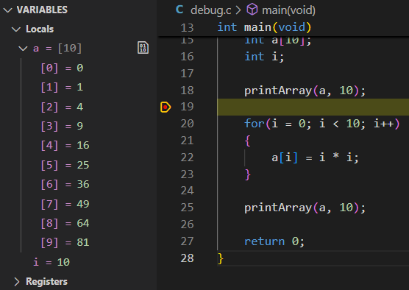
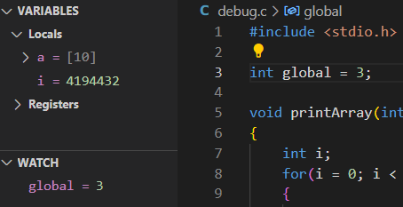
VSCode IDE Debugger – Program States
Tracking All In-Scope Variables
  In halted state, the values of all in-scope
  variables will be displayed in Variables panel
  Don’t worry about Registers. Learn in 2DI4/2DX3.
Watch Additional Variables
  Can also place watches on other non-local variables
  Even out-of-scope ones
  Select the variable, right click, select “add to Watch”

Slide 12
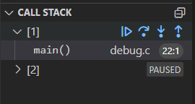
VSCode IDE Debugger – Program States
Call Stack – Tracking All Related Function Calls
  Use this panel to track all the function call relationships
  We will not use this until the topic of Recursion

Slide 13
Debugging Tool 2 – VSCode IDE Debugger
L6Ex1-FiboBug.c
Example – Fix The Same Program
  Compile in Debugger mode
  Modify launch.json with new executable, set externalConsole to true
  Set up breakpoints
  Run program under debugger
  Examine variable values at first breakpoint
  Step through the statements and inspect variable values at every meaningful spot
  Confirm bug, propose fix
  Repeat 5-7 for validation until bug is fixed.
int findFibo(int N)
{
int prevTerm = 1;
int currTerm = 1;
int temp = 0;
int i;
for(i = 0; i <= N; i++)
{
temp = currTerm;
currTerm += prevTerm;
prevTerm = temp;
}
return currTerm;
}
int main(void)
{
int input;
printf(“Which Fibo term? >> ”);
scanf(“%d”, &input);
printf(“Fibo Term %d = %d\n”, input, findFibo(input));
return 0;
}

Slide 14
Debugging Tools - Comparison
Debugging Message
  Quick and simple
  No external tools needed
  Great for incremental validation
  “Lava Code” - unneeded code left in compilation
  Limited scope for monitoring variables
  No statement-by-statement analysis
  Falling short in tracing down more complex bugs
IDE Debugger
  Structured debugging process
  Versatile statement stepping analysis
  Monitoring all in-scope variables at ease
  Capable of tracing down more complex bugs
  Steeper learning curve
  Setup can be very different (and tricky) among IDEs

Slide 15
Debugging Practice
Infinite Loop and Seg Fault Analysis

Slide 16
Debugging Practice – Segmentation (Seg) Fault
Apply debugging tools to fix this code.
Read the comments in the uploaded code to see how this code is “supposed” to work.
L6Ex2-SegFault.c
int main(void)
{
int data[20] = {1, 2, 5, 91, 7, 4, 2, 7, 45, 7, \
2, 12, 8, 59, 41, 5, 83, 13, 25, 6};
int input;
int i = 0;
printf(“Give me an integer >> ”);
scanf(“%d”, &input);
do
{
if(isLarger(input, data[i]))
data[i] = input * 2;
else if(isSmaller(input, data[i]))
data[i] = input / 2;
} while(data[i++] = input);
return 0;
}
int isLarger(int a, int b)
{
return a > b;
}
int isSmaller(int a, int b)
{
return a < b;
}

Slide 17
Debugging Report

Slide 18
Debug Report
Unless in training / review, debug report is typically optional
  But you are engineers under training, so do it ☺
Part of your Engineering Journal
Must-Have Elements
  Identification of bug location and mechanism, supported by debugger info
  Proposal of bug fix and the underlying mechanism
  Validation of bug fix, supported by debugger info
  Detailed mechanism explanation may be optional

Slide 19
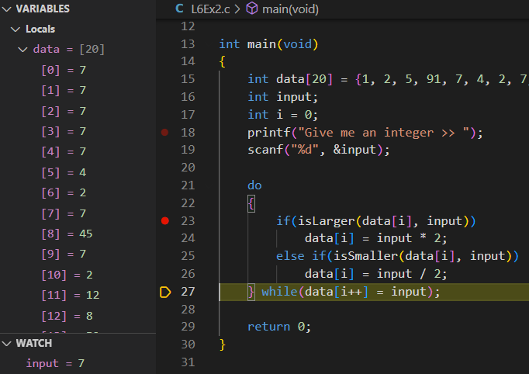
Sample Debug Report for Practice
Bug Observation 1
  Program fails to stop when input equals data element
    Input = 7
    Expected to stop at element 4
    Actual outcome
      Program stuck in infinite loop
Debugger Analysis
  Breakpoint placed at line 23
  Debugger indicates the program failed to recognize
  input == data[4]
    It also overwrites all data by input value, rather
    than assigning input*2 or input/2 accordingly
Possible Root Cause
  Line 27 comparison is written incorrectly as assignment. It should be != instead.

Slide 20
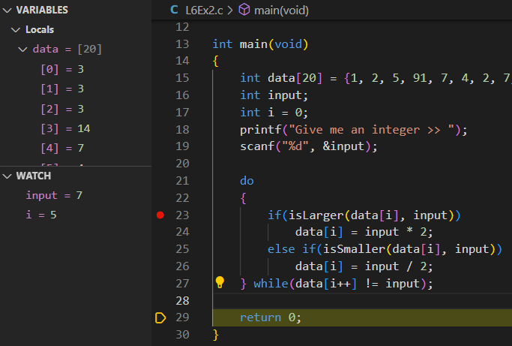
Sample Debug Report for Practice
Bug Fix Validation 1
  Line 27 corrected as while(data[i++] != input);
    Input = 7
    Expected to stop at element 4
      i = 5 breaks do-while loop
    Actual outcome matched

Slide 21
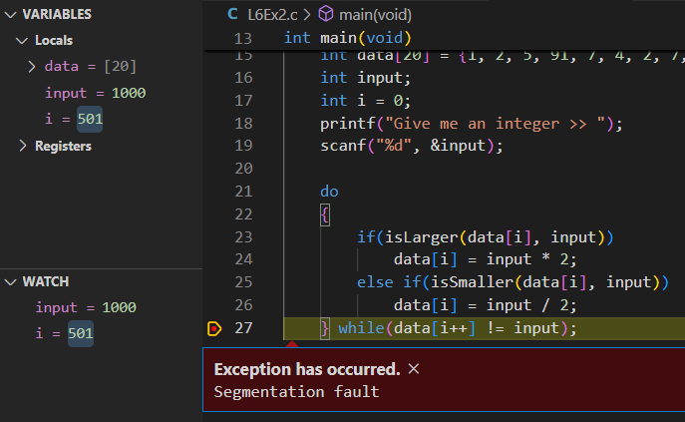
Sample Debug Report for Practice
Bug Observation 2
  Program fails to stop at element 19
    Input = 1000
    Expected to stop at i = 19 with no match found
    Actual outcome
      Program SEGFAULT
Debugger Analysis
  Breakpoint placed at line 27
  The program did not stop after i = 19
  Seg-faulted because it continued on and overwrote
  up to element 500 (out of bound)
  Segmentation Fault at i = 501
Possible Root Cause
  Line 27 comparison is missing one additional condition i < 20.

Slide 22
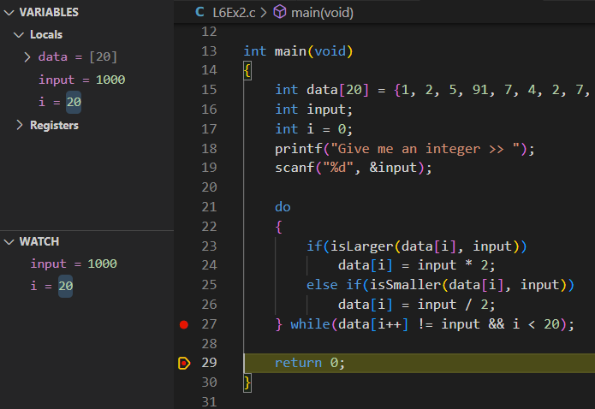
Sample Debug Report for Practice
Bug Fix Validation 2
  Line 27 corrected as while(data[i++] != input && i < 20);
    Input = 1000
    Expected to stop at element 19 (i = 20)
    Actual outcome matched

